Slide 1

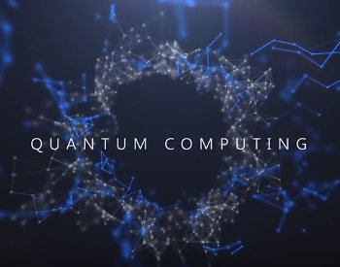
Quantum computing
NAME:- SIDDH GIRISHKUMAR PATEL
ENROL NO:- T2401201112
SUBJECT:- SEMINAR
BATCH:- CE B-3

Slide 2
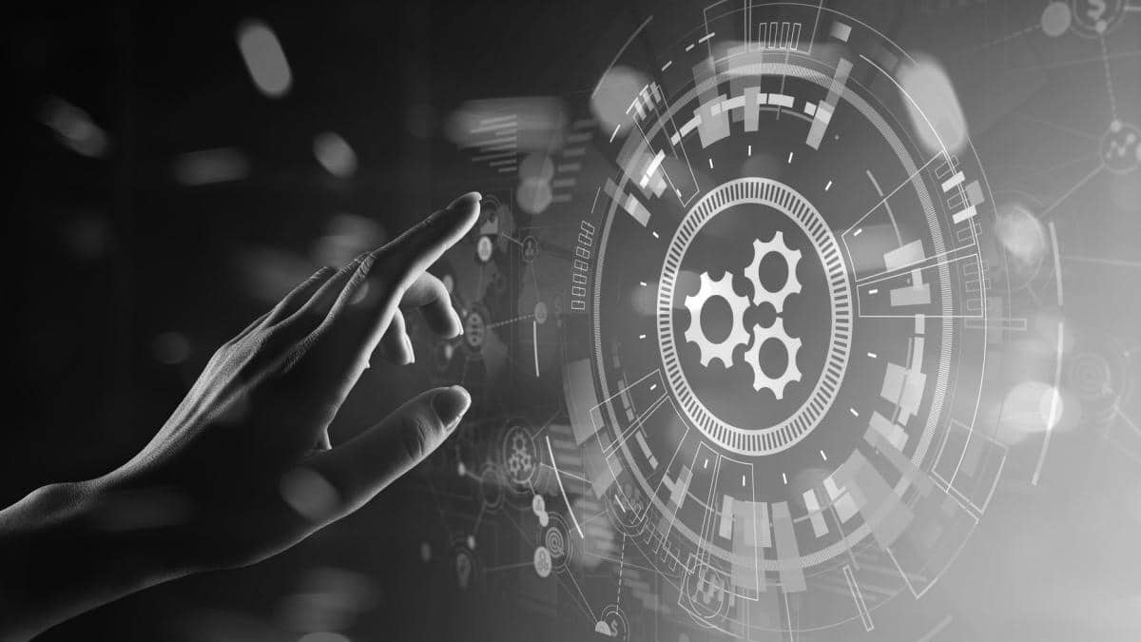
Quantum Computing – The Computing Technology of Tomorrow
Quantum Computing is a subject that can boggle even the most genius minds!!! It deals with topics that are considered science fiction by normal people like parallel universes, multiverse theory, etc.
But Quantum Computing is very real. It is a computing technology based on the laws of QUANTUM PHYSICS, which deals with the behavior of energy and matter at the quantum level.
In fact, Quantum Computing could change entire industries in the future like Healthcare, Finance, Telecommunications, Cybersecurity, etc. with its insane capabilities. And that is why this article focuses on Quantum Computing and its Potential Applications in the Future.
This Photo by Unknown Author is licensed under CC BY

Slide 3
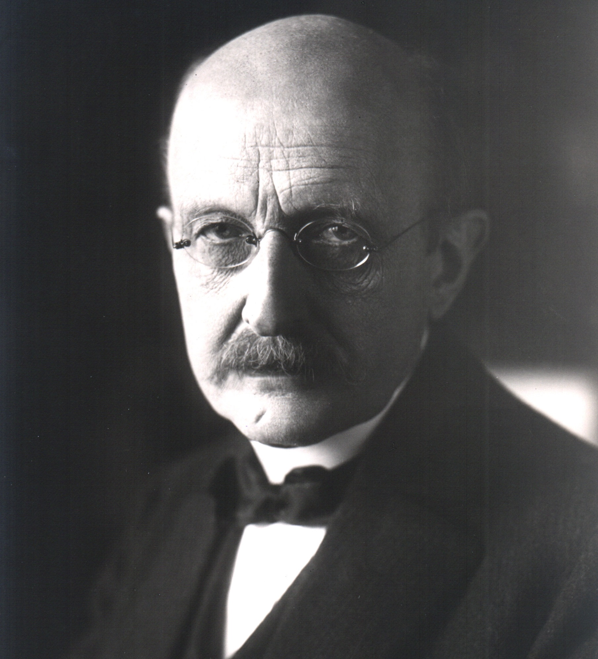
what was the beginning of Quantum computing?
It all started with physicist MAX PLANK in 1900 when he discovered the energy quanta, which are tiny little packets of energy at the subatomic level that can behave as both waves and particles depending on their environment at the time.
This discovery became the basis of the Quantum Theory which earned Max Planck a Nobel Prize in Physics and also led to the start of Quantum Computing.
This Photo by Unknown Author is licensed under CC BY

Slide 4
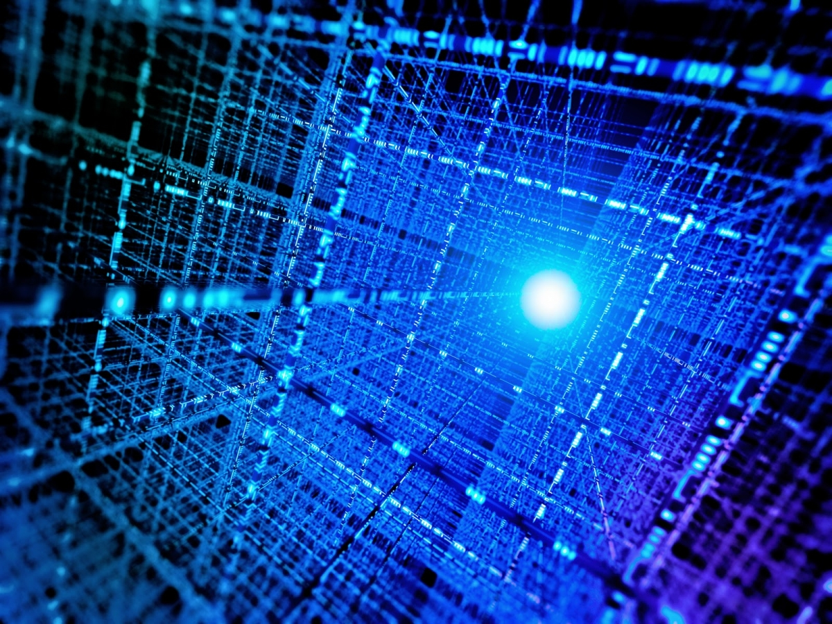
What is Quantum Computing?
Now modern classical computing methods work on chips that process all the data using just a bit with two possible states 0 and 1.
However, there are some problems that are so huge or complex that it is impossible to solve them with even the most powerful classical computers on Earth!!!
Universal Quantum Computers use the unit qubits (quantum bits) instead of bits.
A qubit could be an electron in which the 2 different states are the upward spin or downward spin of an electron or even a photon, in which the 2 different states are the vertical polarization and the horizontal polarization.

Slide 5
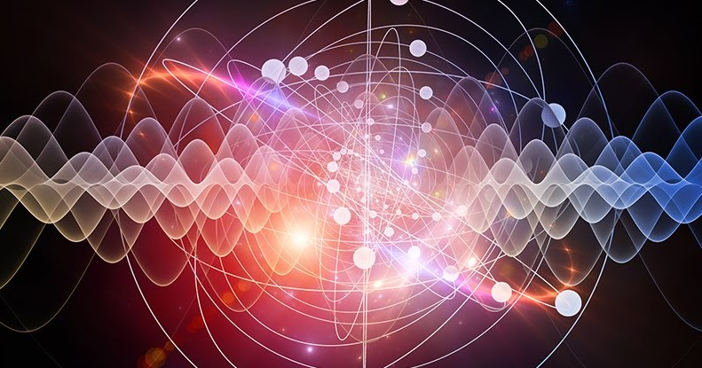
What is Quantum Supremacy?
What would be the use of a Quantum Computer if it could not be at least better than Classical Computers?This is where Quantum Supremacy comes in.
Basically, Quantum Supremacy is the proven ability of a Quantum Computer to solve problems that Classical Computers practically cannot solve.
The race to build the most powerful quantum computers that could attain Quantum Supremacy has been going on since the late 1990s.
der CC BY-SA

Slide 6
What are the Potential Applications of Quantum Computing?
Quantum Computing might be the future of the tech world! According to VERN BROWNWELL, CEO of D-Wave system which is a Canadian Quantum Computing company “We’re at the dawn of this quantum computing age.
In fact, there are many possible applications of Quantum Computers across various fields.
Healthcare
Finance
Cybersecurity
Agriculture
Artificial intelligence

Slide 7

Healthcare
Want a medicine tailored to your unique DNA structure and genomes?
This could potentially be possible using Quantum Computing. Studying the complete DNA of an organism requires a large amount of computational power and storage space which is quite difficult to accomplish using Classical Computing.
However, Quantum Computing would make this process much easier allowing us to understand individual DNA at a much deeper level and also cure many genetic diseases.
This Photo by Unknown Author is licensed under CC BY

Slide 8

Finance
Finance involves market prediction
inorder to make more money!!!
Now there are many algorithms that use multiple probabilities and assumptions to calculate the future market trends.
Quantum Computers can be immensely helpful in this scenario as they can eliminate the blind spots and errors in the data which leads to wrong financial forecasts.

Slide 9

Cybersecurity
Do you know that the insane speed of Quantum Computers could be used to crack the cryptographic codes that keep our messages and sensitive data a secret?
But at the same time, Quantum Computers could also be used to protect the data from hacking using Quantum Encryption.
It involves sending photons over long distances using the Entanglement Principle to secure the data.

Slide 10
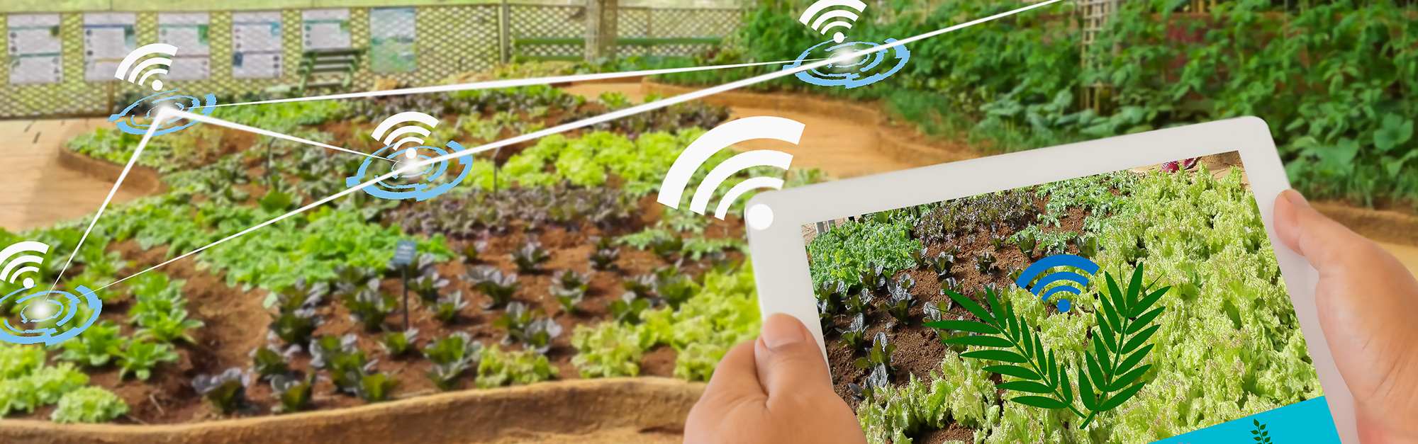

Agriculture
Fertilizers are very important in Agriculture!!! And they are made primarily of Ammonia.
But did you know that we still use a technique from the 1900s to create Ammonia which requires extreme pressure and heat?
And no new process for creating Ammonia has been discovered as there are millions of possible catalyst combinations to try.
Solving this problem on a Classical Computer may take ages but this can easily and speedily be done on a Quantum Computer.

Slide 11
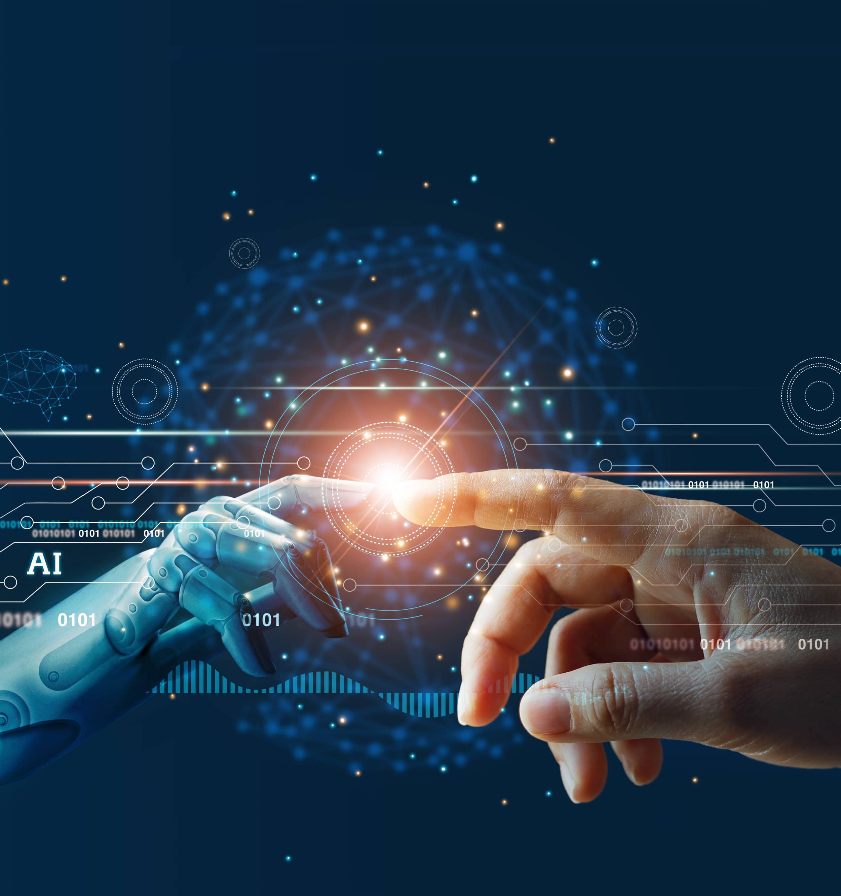
Artificial Intelligence
Artificial Intelligence is interesting on its own and Quantum Computing could make it almost magically diverse.
Complex algorithms could be created on Quantum Computers that may be able to map out trillions of neurons in the human brain and contribute hugely in the field of neural networks.
Also, Quantum Computing could be used in combination with ML to create IoT devices that are deeply interconnected with insanely complicated cybersecurity protocols.

Slide 12
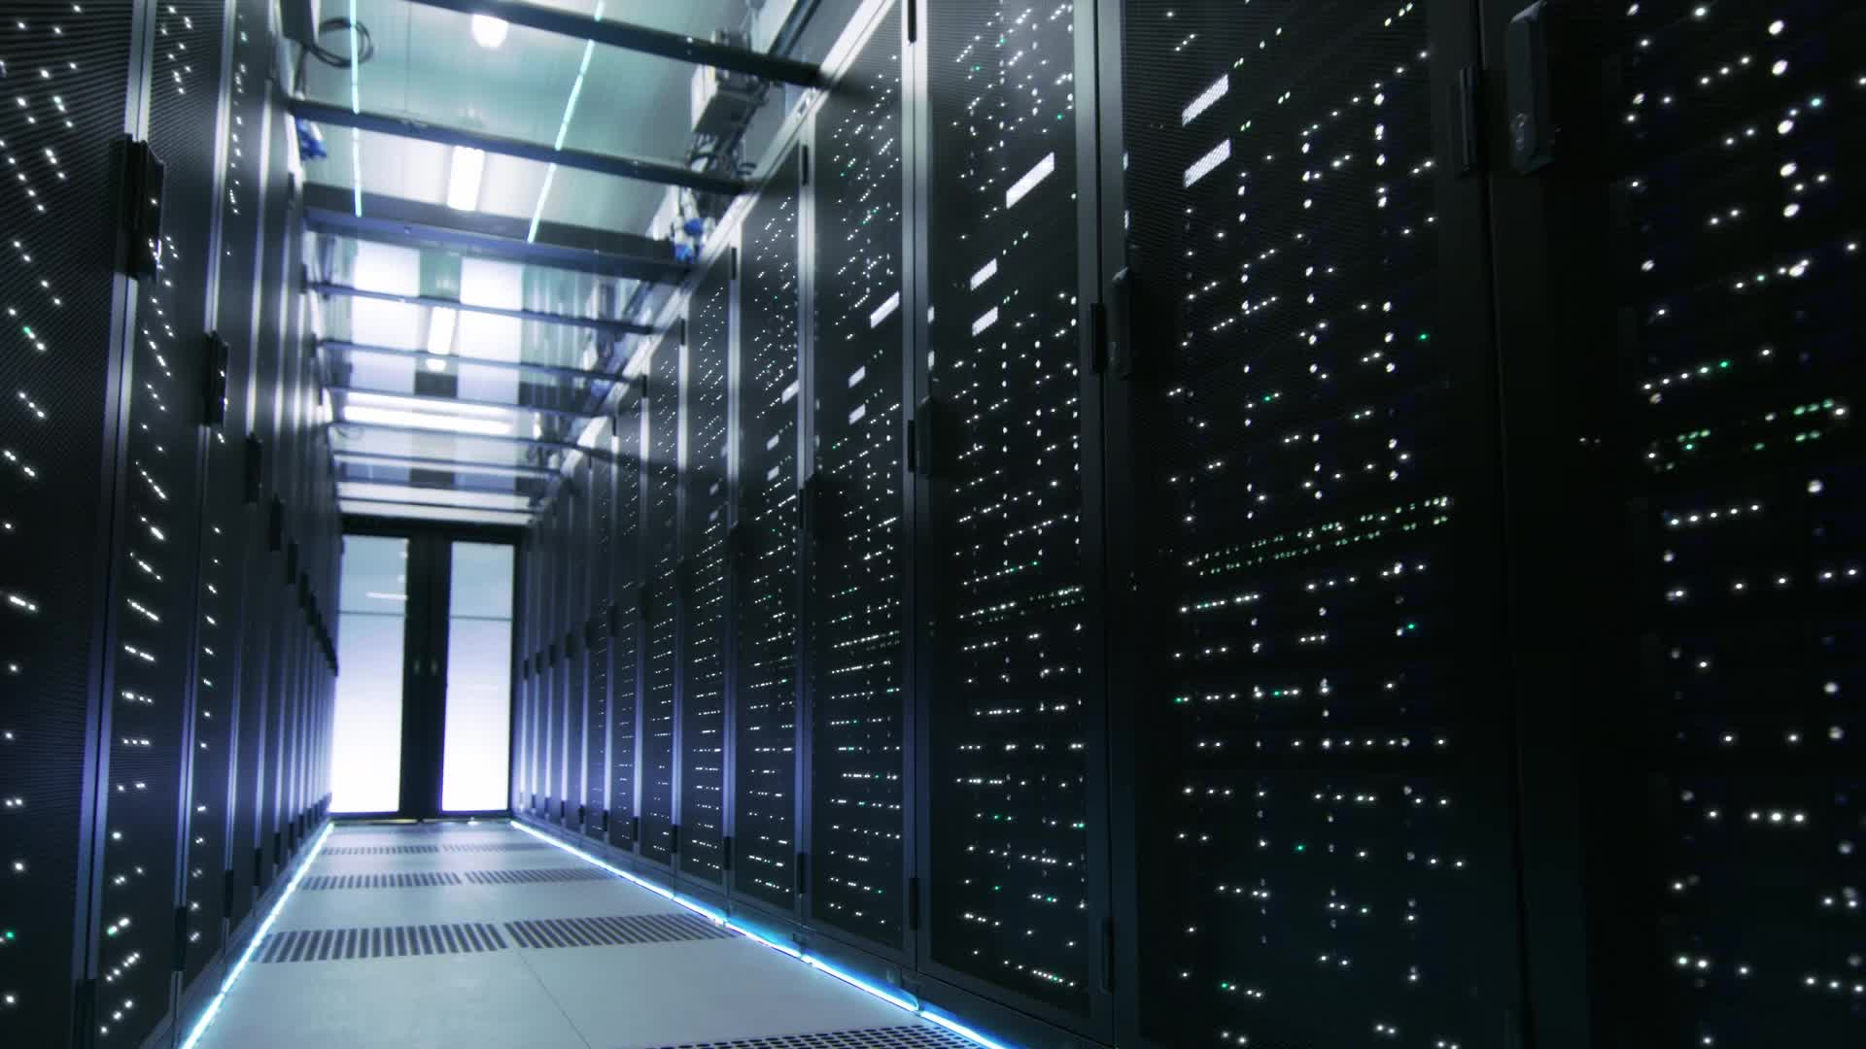
Quantum computing
Introduction: In this era of supercomputers, quantum computing is considered as the next big thing. It has been theorized that quantum computes will take a huge leap over the supercomputers.
To put this into perspective, supercomputers have achieved a peak performance of around 200 petaflops or 200, 000 trillion calculations per second.
Quantum Computers will be able to achieve a billion times more performance power.

Slide 13
Ideology regarding quantum computer
A quantum computer will be able to perform any task that a classical computer is able to perform.
Although, there is a catch. If we use classical algorithms on a quantum computer, it will simply perform the calculation in a similar manner to a classical computer.
For a quantum computer to be utilized to its full potential, quantum algorithms need to be formulated. Quantum algorithms can exploit the phenomenon of quantum parallelism.
These algorithms are not easy to create, requiring a lot of research and development. A well-known example for one of the algorithms is the quantum factorization algorithm created by Peter Shor of AT&T Bell laboratories.
What the algorithm does is tackle the problem of factorizing large numbers into its prime factors. This task is classically very difficult to solve (base on current technology).
Shor’s algorithm cleverly uses the effects of quantum parallelism to give the results of the prime factorization problem in a matter of seconds.

Slide 14
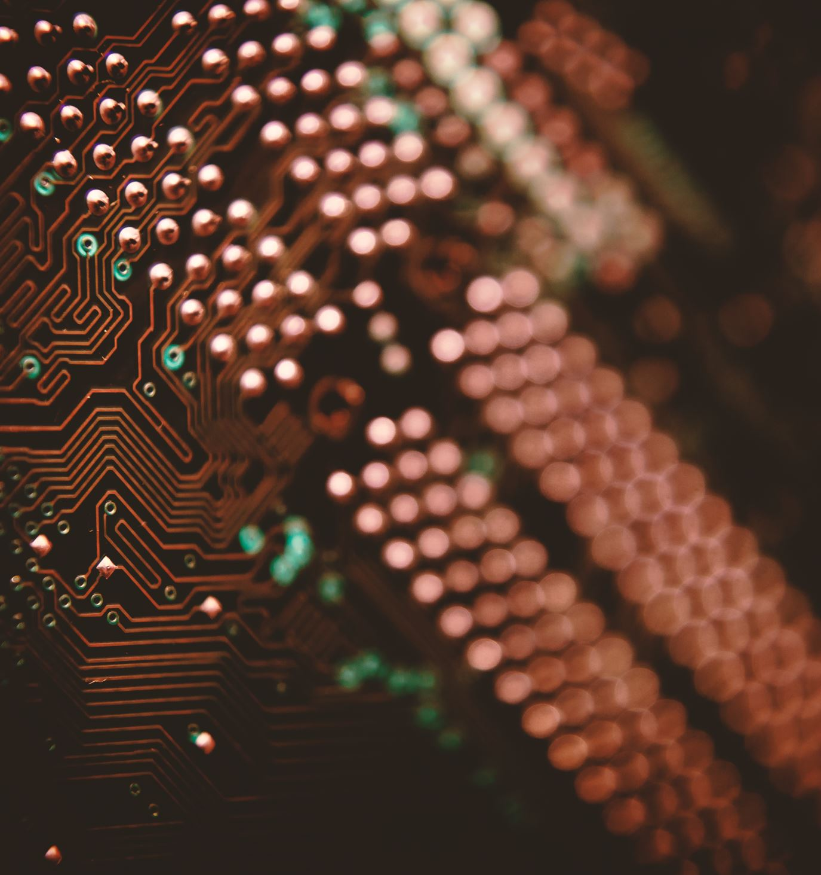
Pros of Quantum Computing
Speed: Quantum computers are substantially quicker than conventional computers at some sorts of computations, particularly when factoring big numbers and modelling quantum processes.
Parallelism: Due to the simultaneous processing of many calculations by quantum computers, certain types of problems can be solved much more quickly.
Large-scale optimization: Compared to conventional algorithms, quantum algorithms are faster and more accurate at solving complex optimization issues.
Simulating quantum systems: A quantum computer can be used to simulate quantum systems more effectively and precisely than conventional computers since it is based on the ideas of quantum physics.
Cryptography: Quantum computers have the ability to crack some of the encryption used by conventional computers, but they also present fresh possibilities for private communication.

Slide 15
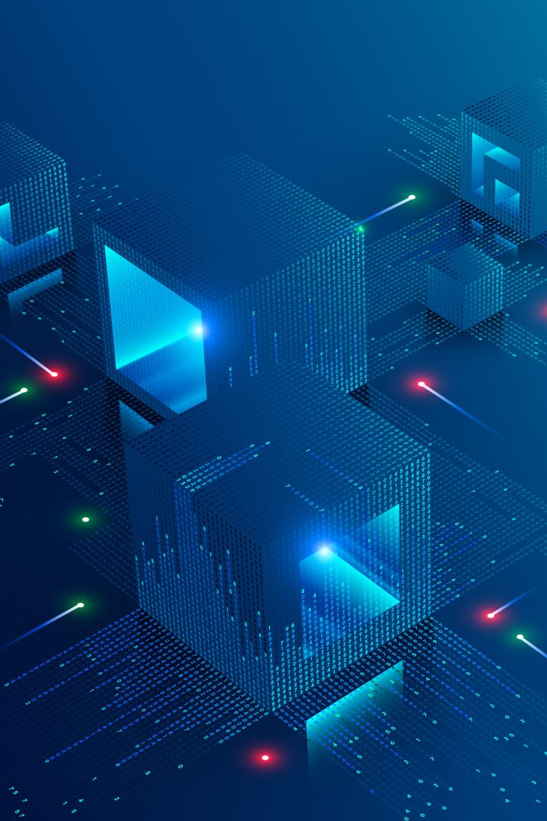
Cons of Quantum Computing
Hardware: The size and stability of existing quantum computers are constrained, and developing a large-scale, dependable quantum computer is a big engineering problem.
Software: The field of creating quantum algorithms and software is still developing, and qualified professionals are in short supply.
Cost: Building and maintaining quantum computers is currently relatively expensive, and this may prevent widespread deployment.
Noise and mistakes: Compared to conventional computers, quantum computers are more prone to noise and faults, and fixing these errors is a difficult task.
Scalability: At the moment, quantum computers are only partially scalable, and it is yet unclear how to construct a robust, large-scale quantum computer that is capable of solving complex problems.
Interoperability: Due to the lack of standards in the realm of quantum computing, it might be challenging to compare and combine various quantum computers.

Slide 16
conclusion
A classical computer would take, in some cases, more than the age of the universe to produce a result.
It is clear that breakthroughs are required not just in technology, but also in algorithm and we do require other supporting technology such as leverage of machine learning (ML), artificial intelligence (AI), Big Data, Cloud Computing to accelerate Quantum Computing development.

Slide 17
Thank you

